Slide 1
“LADS” (License Authorization and Driver’s Safety)
Gravi-T

Slide 2
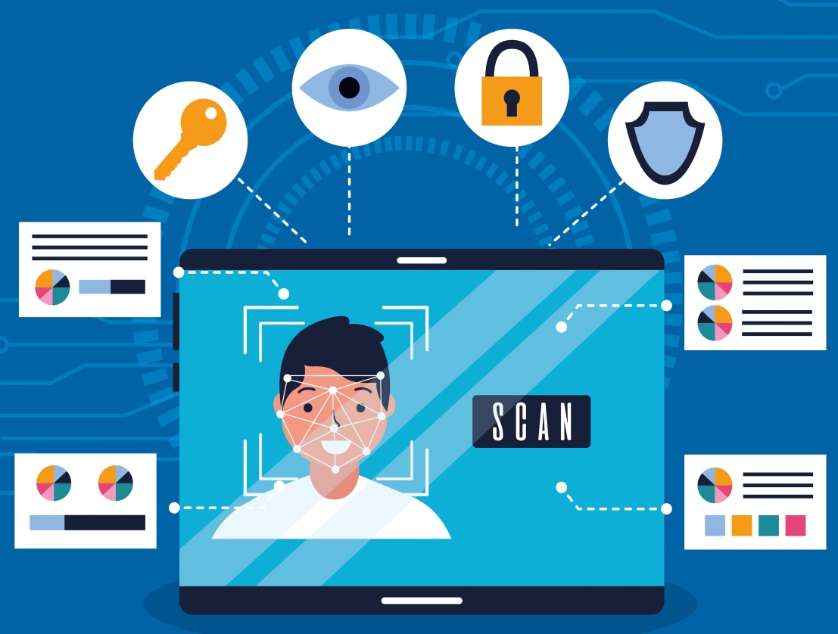
Road Safety and Awareness
There are many factors that contribute to road accidents, some of the major factor includes Driver dizziness and presence of unauthorized drivers. This software provides a solution to eliminate these factors and ensure a safe ride for the driver and others on road.

Slide 3



TECHNOLOGY STACK
Python
Open CV,
Dlib,
FaceRecognition
Transfer Learning
For programming, using Numpy module
For Face Recognition
For Modeling

Slide 4
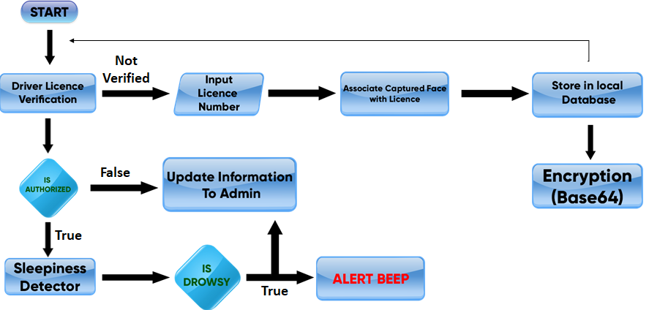
SOLUTION FLOWCHART

Slide 5
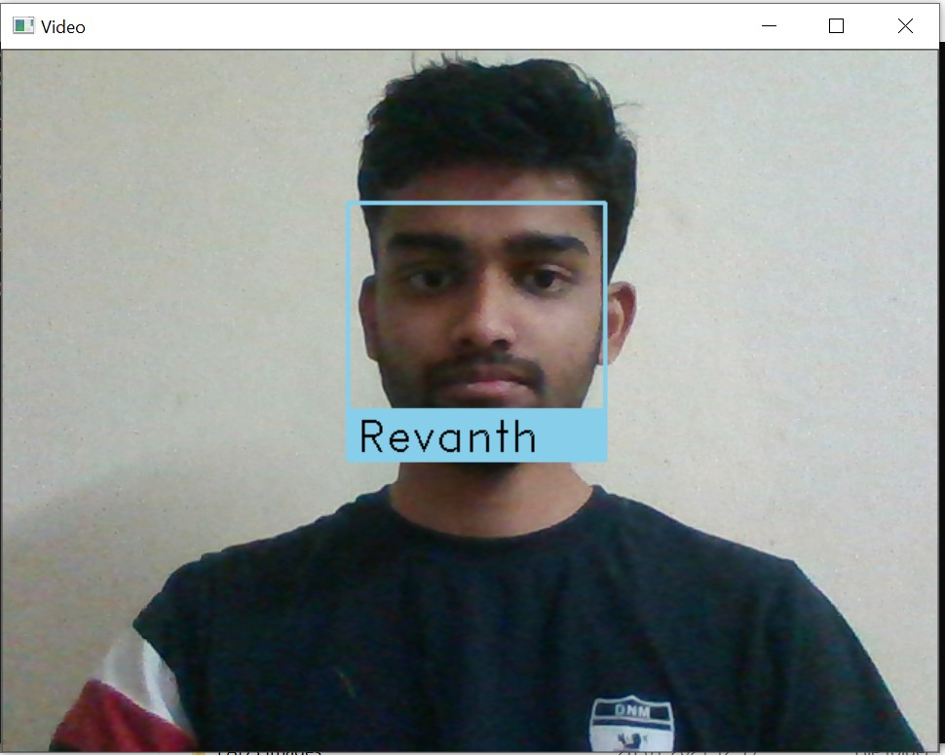
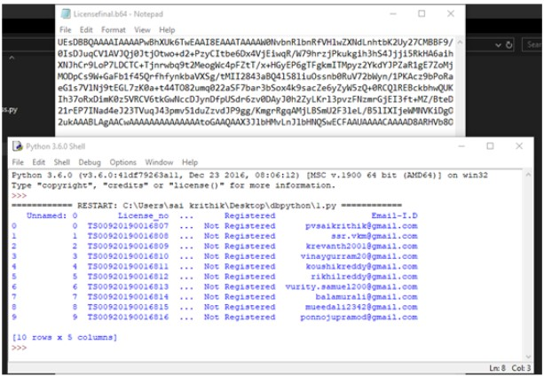
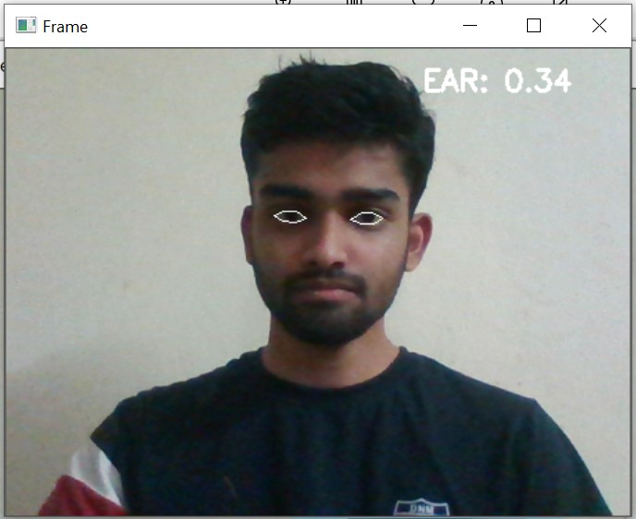
SCREENSHOTS

Slide 6
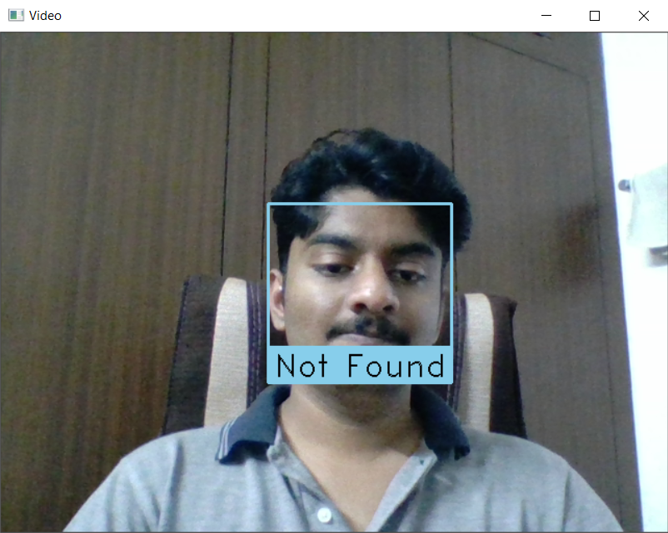
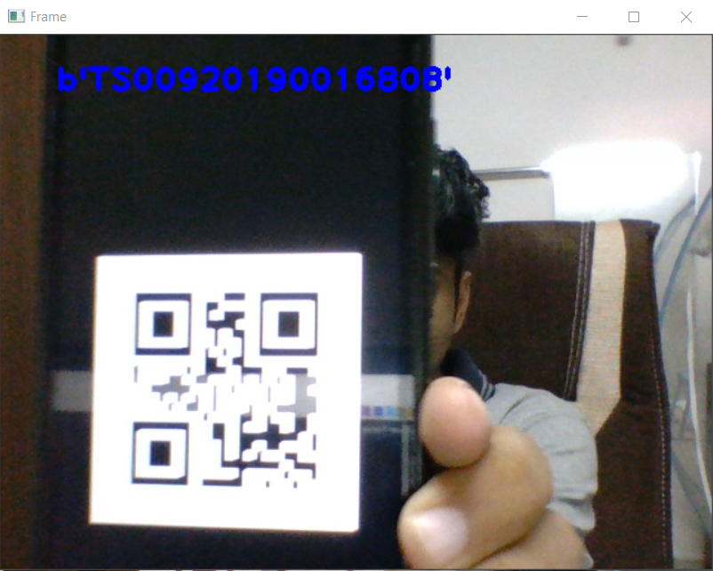
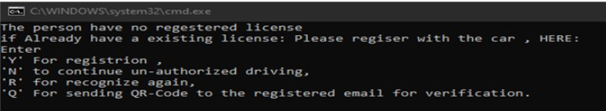

Slide 7
Existing solutions
Driver distraction and drowsiness detection system – Dcube
Major Differences between the models:
Faster Image Processing with accuracy of 0.96
Extra features like:
License Authorization
User security with Data Encryption

Slide 8
Thank You
Link to Github Repository

